Slide 1
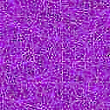
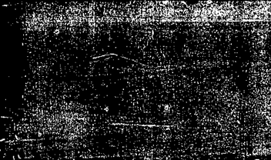
Smart Glove for Sign Language Translation
Submitted By: Group 5​
Instructor: Mr. Raiyan Basher
Course: EEE 3404(A) Microprocessor and Interfacing Laboratory
​Institution: United International University​

Slide 2
Group Members:
2. Azad Hossain Saykat - 021 221 017
4. Suvom Karmakar - 021 221 027
1. Sazzad Hossen - 021 221 026
3. Md. Tahman Hossain – 021 221 099
5. Sabiha Hossain Mim – 021 221 007

Slide 3
Introduction
1. Many people who use sign language face difficulties communicating with others who don’t understand it.
2. Our Smart Glove for Sign Language Translation helps by turning hand gestures into speech and text in real-time.
3. The glove has flex sensors and an IMU sensor to track finger and hand movements.
4. An STM32 microcontroller processes the data and recognizes different sign language gestures.
5. A machine learning model helps convert these gestures into audio and text, making communication easier.
6. The system is portable, affordable, and easy to use, helping people connect more easily.

Slide 4
Required Components
Flex Sensors, Touch Sensor.
MPU6050 Gyroscope – Tracks hand movements and orientation.
STM32 Microcontroller.
USART TTL Module – Handles data communication.
Bread Board and Gloves

Slide 5
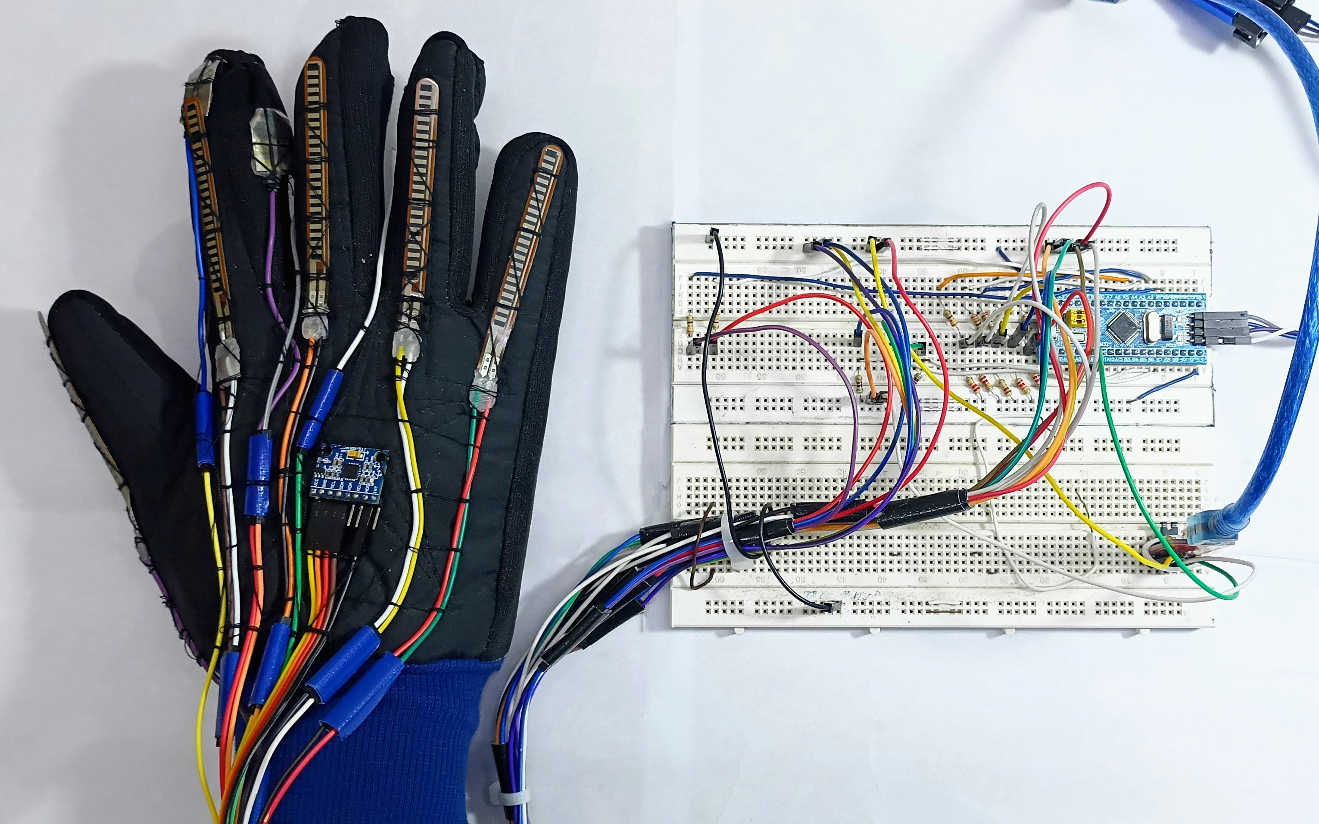
Hardware Implementation
Touch Sensor
Flex Sensors
MPU6050 Gyroscope
Fig: Smart Glove System with Sensors and Circuitry

Slide 6
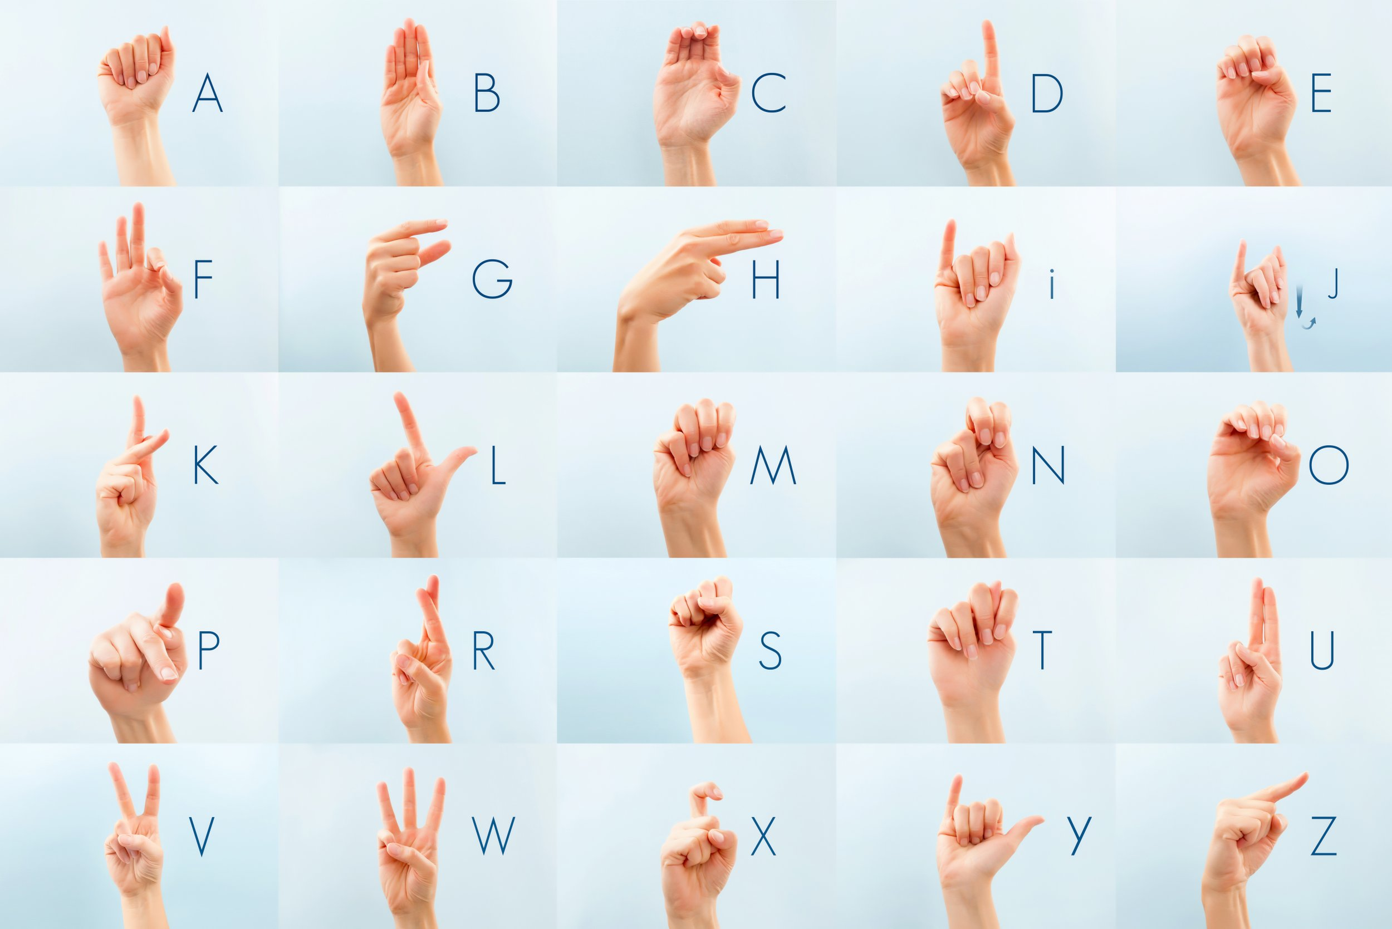
Hand Gesture
Fig: American Sign Language

Slide 7
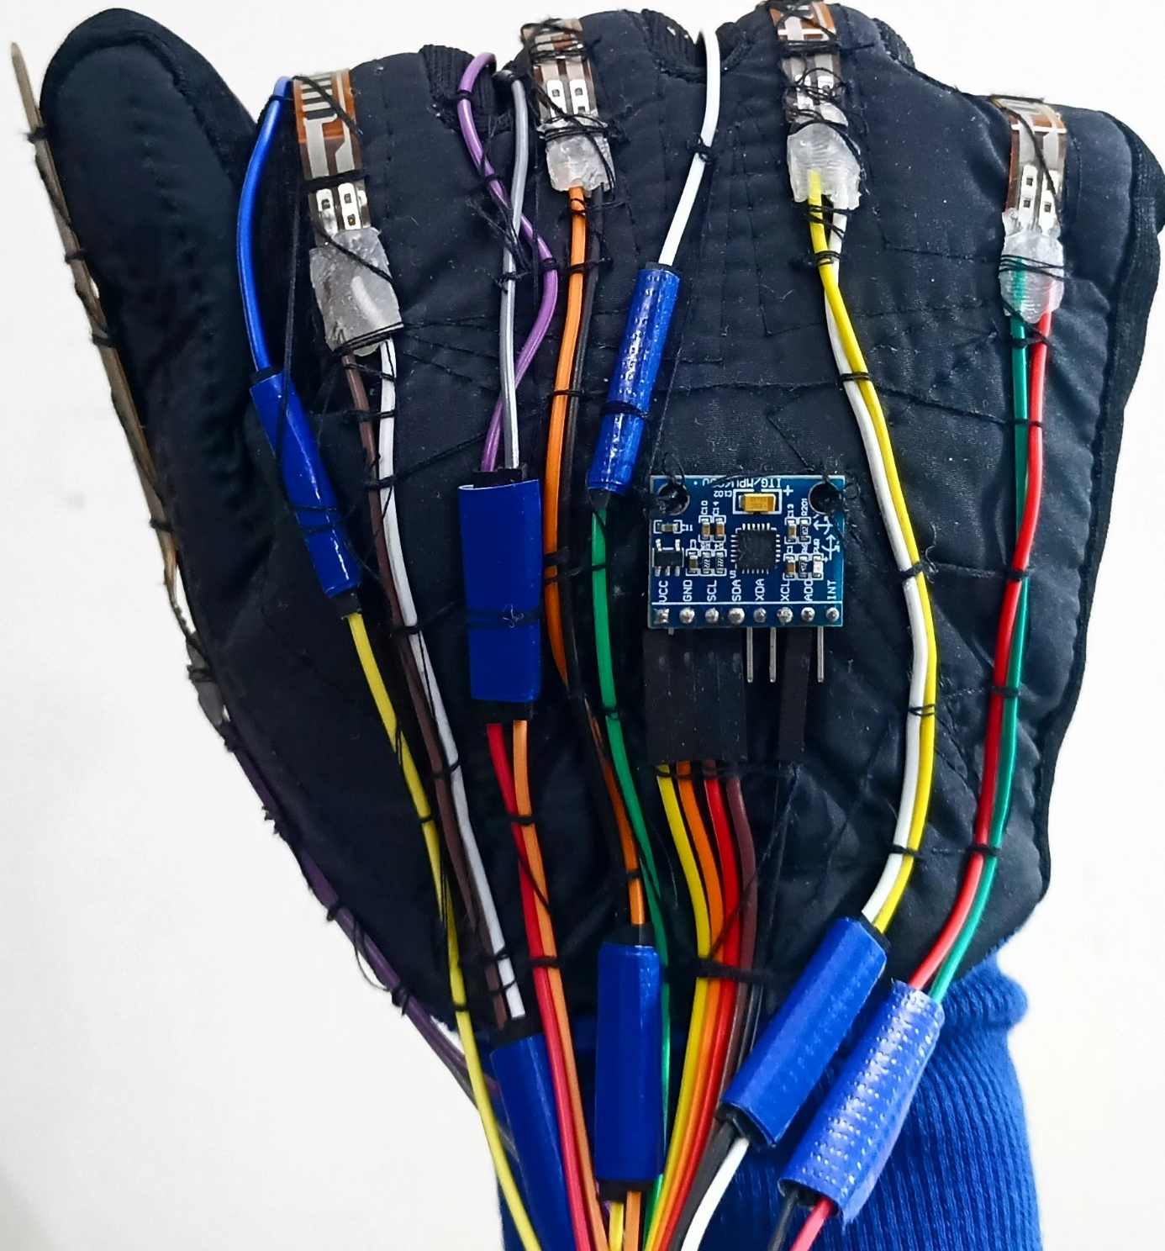
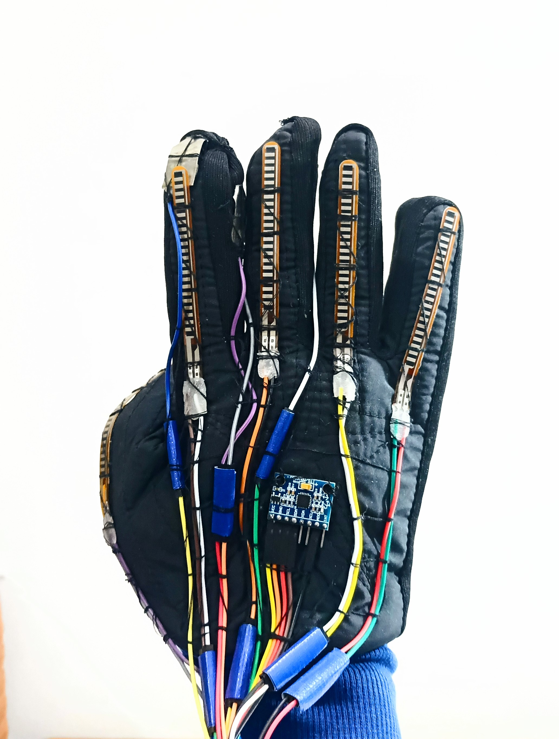
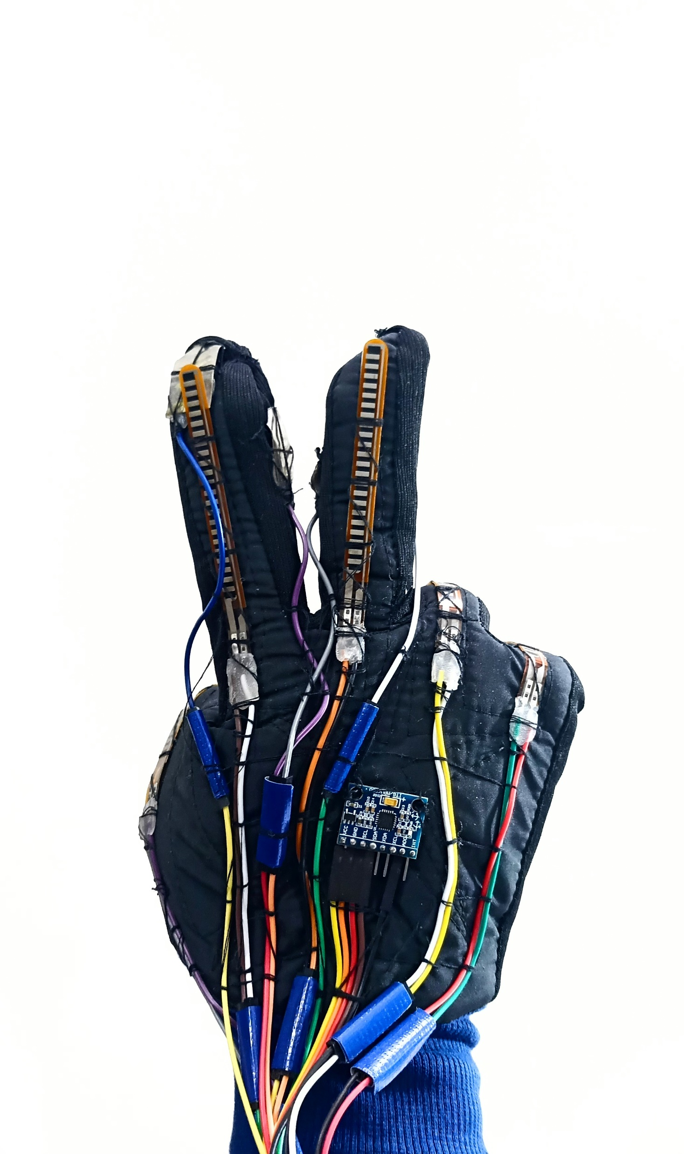
Hardware Implementation
a | b | v

Slide 8
Video Presentation
Sign Language Glove

Slide 9
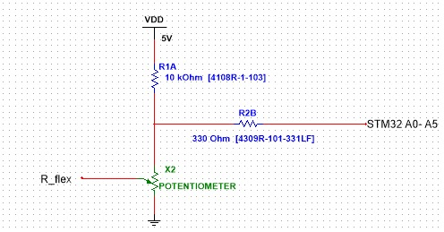
Software Design (Flex Sensor)
What is a Flex Sensor?
A Flex Sensor is a variable resistor that changes its resistance depending on the amount of bending or flexing applied.
In the context of the smart glove, it is used to detect finger movements and positions.
How It Works in the Glove:
Placed on the back of each finger to detect bending.
Resistance increases as the finger bends.
Integrated into a voltage divider circuit to convert
resistance into voltage.
Data Processing:
Voltage output is sent to the microcontroller’s ADC.
Digital values are used to recognize finger positions.
Why Flex Sensors?
Accurate detection of finger bending.
Compact and reliable for consistent gesture recognition.
Working Principle:
Flex Sensors change resistance based on finger bending.
Integrated into a voltage divider circuit to convert resistance
changes into voltage.
Vout = Vin * ( R1 / (R1 + R2) )
R1 = 10kΩ (optimized for best range).
R2: Flex Sensor resistance (10kΩ - 17kΩ).
Output Range:
Output voltage range is ~1V for 3.3V input.
Sufficient for the microcontroller’s ADC to differentiate gestures.

Slide 10
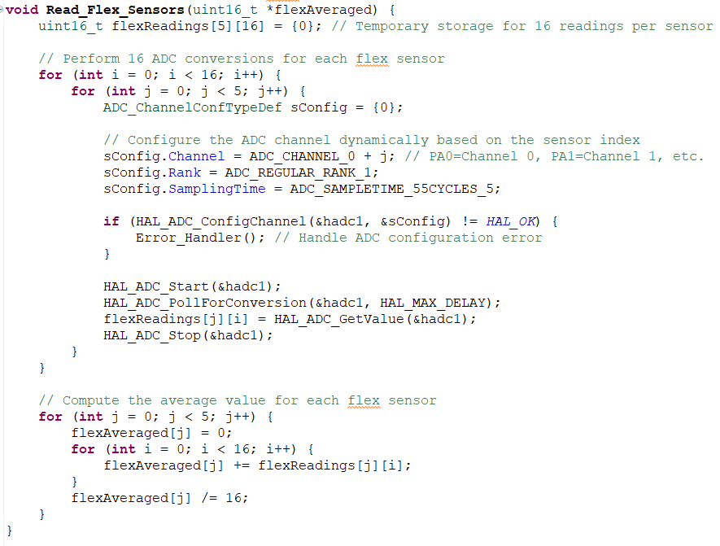
Software Design (Flex Sensor)
Data Storage Setup
Uses flexReadings[5][16] to store 16 ADC readings per sensor.
ADC Conversion Process
Loops through 5 flex sensors (j = 0 to 4).
Each sensor gets 16 ADC readings (i = 0 to 15).
Configures ADC channel dynamically based on sensor index.
ADC Configuration & Reading
Sets ADC channel dynamically (ADC_CHANNEL_0 + j).
Defines sampling time and regular rank.
Reads ADC values and stores them in flexReadings[j][i].
Compute Average Value
Loops through each sensor (j) to process data.
Sums up 16 readings for each sensor.
Computes the average (flexAveraged[j] = sum/16).

Slide 11
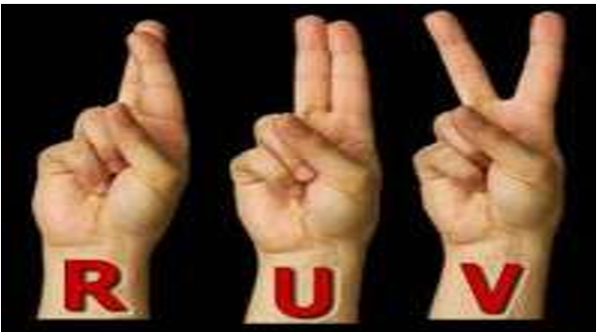
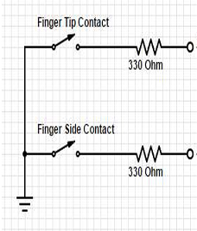
Software Design (Touch Sensor)
Touch sensor
A touch sensor in form of a copper tape are used here
to create a binary input value to the microcontroller
to indicate the presence of contact or lack of it.
Why it is needed?
The hand symbol of “R”, “U”, “V” are quite similar.
To differentiate between them, the touch sensors are needed.
For any contact, the resulting output is 1. for no contact, the output is 0.
Placement
One set on the tops of the index and middle finger.
Another set in between the index and middle finger.
Functionality
Functions as switches that would pull the MCU pins to ground to signal contacts.
Working Principle
If any set comes to contact, they give output 1, else output 0
Sends data in packet to the microcontroller

Slide 12
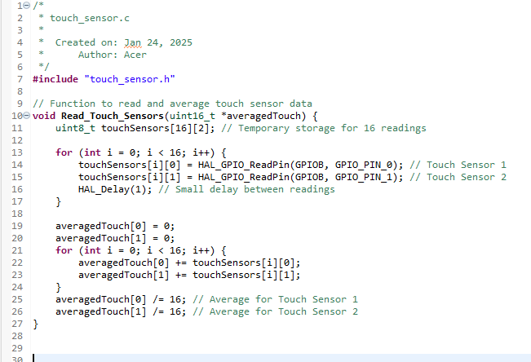
Software Design (Touch Sensor)
Data Storage
Declares a function named Read_Touch_Sensors.
It takes a pointer to an array (uint16_t *averagedTouch) where the averaged sensor values will be stored.
Creates a 2D array called touchSensors with 16 rows and 2 columns.
Each row stores readings for two touch sensors.
The values are stored as uint8_t because each reading is either 0 (no touch) or 1 (touch detected).
Initial Setup
Loop iterates 16 times, collecting 16 samples for each sensor.
Reads the state of GPIO pin 0 (sensor 1) and GPIO pin 1 (sensor 2) from port B.
Adds a 1-millisecond delay between each reading. This ensures that readings are taken at slightly different times instead of all at once.
Initializes the averaging variables to zero.
Result
Iterates through the stored readings. Sums up all readings for sensor 1 and sensor 2 separately.
Divides the sum by 16 to calculate the average. Since each reading is either 0 or 1, this will result in a fractional value (which gets truncated to an integer since averagedTouch is uint16_t).

Slide 13
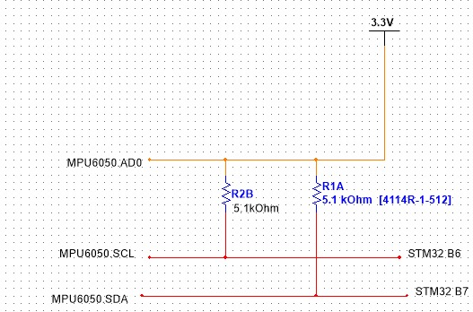
Software Design (MPU6050)
What is MPU 6050?
The MPU-6050 is a popular 6-axis motion tracking IC (3-axis gyroscope and 3-axis accelerometer) that communicates via I2C.
#define MPU6050_ADDR 0x68 << 1 // Shifted left for STM32 HAL
void MPU6050_Init(void) {
uint8_t data;
// Check MPU6050 WHO_AM_I Register
HAL_I2C_Mem_Read(&hi2c1, MPU6050_ADDR, 0x75, 1, &check, 1, HAL_MAX_DELAY);
if (check == 0x68) { // Check if the response is correct
// Wake up the sensor by writing 0 to the power management register
data = 0x00;
HAL_I2C_Mem_Write(&hi2c1, MPU6050_ADDR, 0x6B, 1, &data, 1, HAL_MAX_DELAY);
// Configure accelerometer range to ±2g (default)
data = 0x00;
HAL_I2C_Mem_Write(&hi2c1, MPU6050_ADDR, 0x1C, 1, &data, 1, HAL_MAX_DELAY);
// Configure gyroscope range to ±250°/s (default)
data = 0x00;
HAL_I2C_Mem_Write(&hi2c1, MPU6050_ADDR, 0x1B, 1, &data, 1, HAL_MAX_DELAY);
}
}
#define ACCEL_XOUT_H 0x3B
void MPU6050_ReadAccelGyro() {
// Read 14 bytes starting from ACCEL_XOUT_H
HAL_I2C_Mem_Read(&hi2c1, MPU6050_ADDR, ACCEL_XOUT_H, 1, rawData, 14, HAL_MAX_DELAY);
// Combine high and low bytes for accelerometer
accel_x_raw = (int16_t)(rawData[0] << 8 | rawData[1]);
accel_y_raw = (int16_t)(rawData[2] << 8 | rawData[3]);
accel_z_raw = (int16_t)(rawData[4] << 8 | rawData[5]);
// Combine high and low bytes for gyroscope
gyro_x_raw = (int16_t)(rawData[8] << 8 | rawData[9]);
gyro_y_raw = (int16_t)(rawData[10] << 8 | rawData[11]);
gyro_z_raw = (int16_t)(rawData[12] << 8 | rawData[13]);
}

Slide 14
Averaging Data in MPU6050 & Making the Packet
// Collect 16 readings
for (int i = 0; i < 16; i++) {
MPU6050_ReadAccelGyro();
accelGyroSensors[i][0] = accel_x_raw;
accelGyroSensors[i][1] = accel_y_raw;
accelGyroSensors[i][2] = accel_z_raw;
accelGyroSensors[i][3] = gyro_x_raw;
accelGyroSensors[i][4] = gyro_y_raw;
accelGyroSensors[i][5] = gyro_z_raw;
HAL_Delay(2); // Small delay between readings
}
// Average the data
Average_Sensor_Data();
void Average_Sensor_Data(void) {
memset(sensorsFiltered, 0, sizeof(sensorsFiltered));
for (int i = 0; i < 6; i++) {
for (int j = 0; j < 16; j++) {
sensorsFiltered[i] += accelGyroSensors[j][i] >> 8;
}
}
}
void Prepare_Packet(void) {
// Add header bytes
packet[0] = 0xA1;
packet[1] = 0xB2;
packet[2] = 0xC3;
packet[3] = 0xD4;
// Add IMU data
for (int i = 0; i < 6; i++) {
packet[4 + i * 2] = sensorsFiltered[i] & 0xFF; // Lower byte
packet[5 + i * 2] = (sensorsFiltered[i] >> 8) & 0xFF; // Upper byte
}
// Add Flex sensor data
for (int i = 0; i < 5; i++) {
packet[16 + i * 2] = flexAveraged[i] & 0xFF; // Lower byte
packet[17 + i * 2] = (flexAveraged[i] >> 8) & 0xFF; // Upper byte
}
// Add Touch sensor data
packet[26] = averagedTouch[0]; // Touch sensor 1
packet[27] = averagedTouch[1]; // Touch sensor 2
// Compute checksum
uint16_t checksum = 0;
for (int i = 4; i < 28; i++) {
checksum += packet[i];
}
packet[28] = checksum & 0xFF; // Lower byte of checksum
packet[29] = (checksum >> 8) & 0xFF; // Upper byte of checksum
}
HAL_UART_Transmit(&huart1, packet, sizeof(packet), HAL_MAX_DELAY);

Slide 15
ML
Machine Learning Code in Python
# Gather data # gatherData(port, dataSet) % To gather alphabet as well as nothing and relaxed # gatherAlphabet(port, dataSet) % To gather alphabet as well as nothing and relaxed # --------------------------------- # Print data set print "\nData Set Size:" for label, instanceList in sorted(dataSet.data.items()): print label, len(instanceList) # Plotting # plotClasses(dataSet) # plotSensor(dataSet) # getAllReportPlots(dataSet, "/home/robert/temp") # --------------------------------- # Learning # simpleTrainAndTest(dataSet) % To train the ML from gather data # clf = trainSVM(dataSet) # testSVM(clf) # --------------------------------- # Continious Prediction # gestureToSpeech(port, dataSet) % To see the output from gesture # - --------------------------------

Slide 16
Challenges and Solutions
Data not transfer properly by UART
Flex sensor bending resistance is not high enough
Not being able to use scan conversion mode of ADC
Unavailability of copper tape

Slide 17
Future Scope
we train a gesture-recognition system using Python on my computer. but in future The trained model's key information is can be then put into STM32 microcontroller's program. This lets the microcontroller recognize gestures on its own, without needing machine language.

Slide 18
Conclusion
In conclusion, our smart glove translates hand gestures into meaningful outputs using sensors and a microcontroller. Calibration improves accuracy, and the system can be further enhanced with better sensors. This technology has great potential for assistive communication and control applications

Slide 19
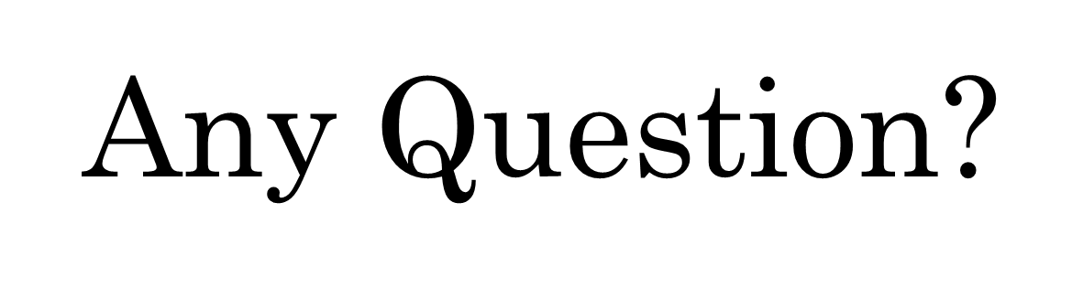
Thank You

